Slide 1
Managing your “beautiful” nereid webshop
Rituparna Panda

Slide 2
Features:
Ready to use out of the box
Customized Templates
One database to do everything
Responsive Webshop
Secured Checkout process
Happy Customers :-)

Slide 3
Ready to use out of the box
pip install openlabs_nereid_webshop

Slide 4
Google Ready

Slide 5
Google Ready

Slide 6
Google Ready

Slide 7
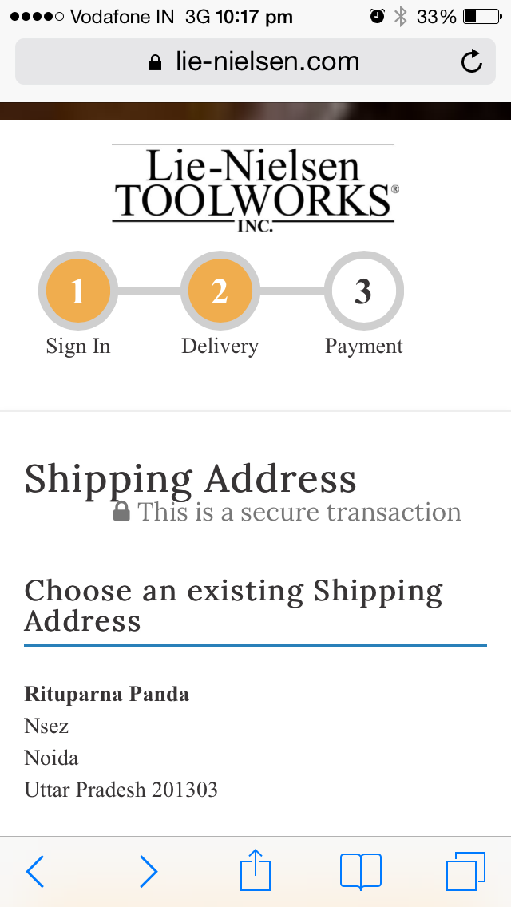
Responsive Webshop

Slide 8
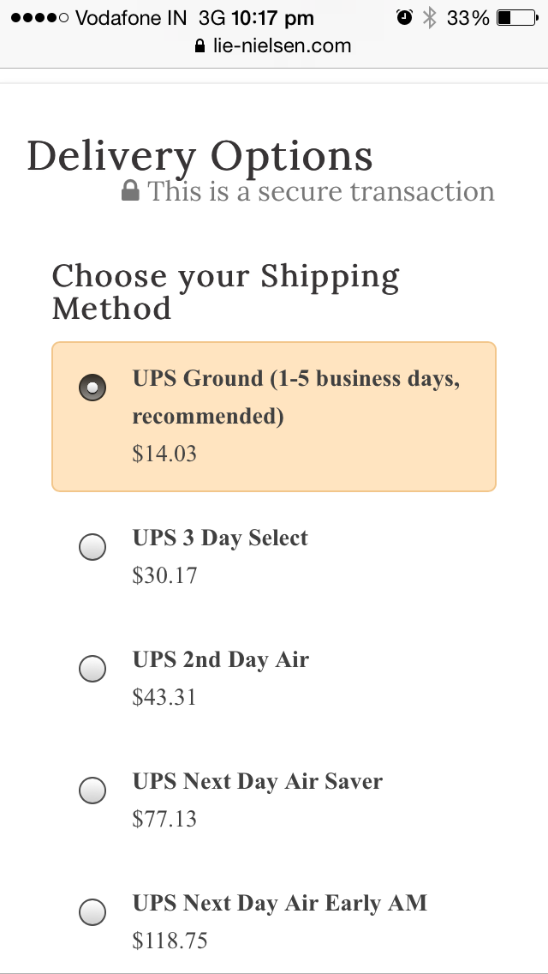
Responsive Webshop

Slide 9
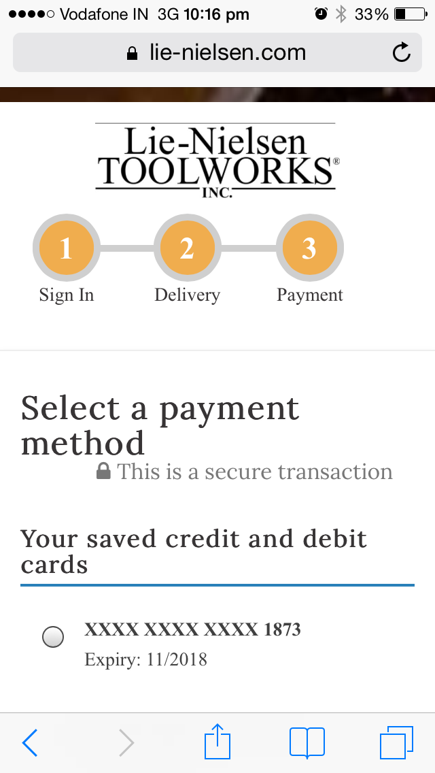
Responsive Webshop

Slide 10
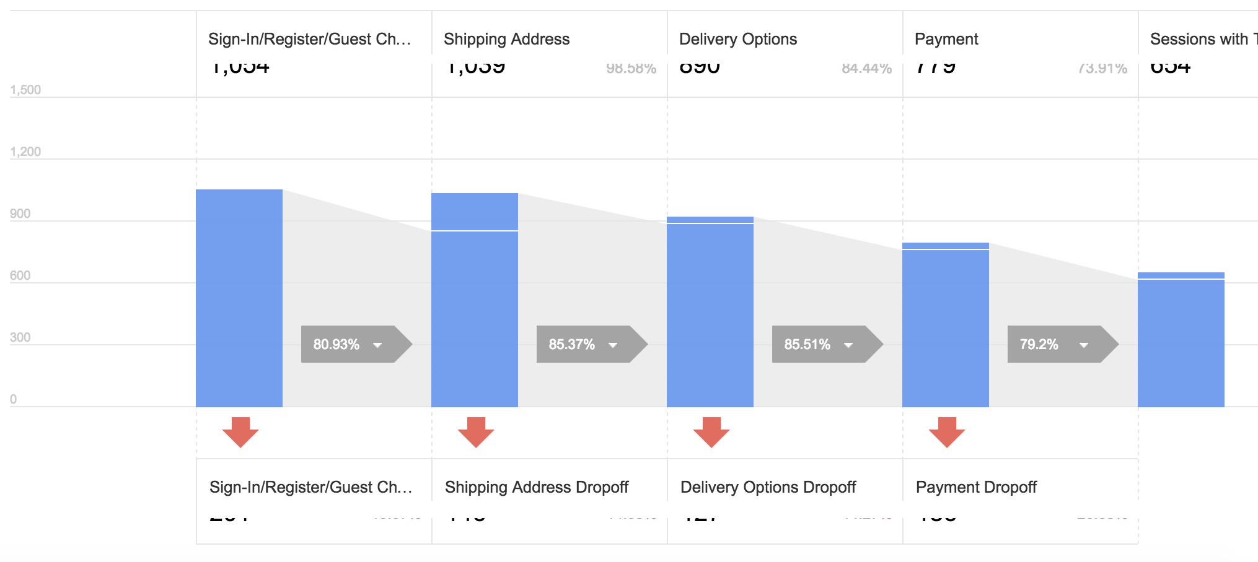
Google Analytics - eCommerce

Slide 11
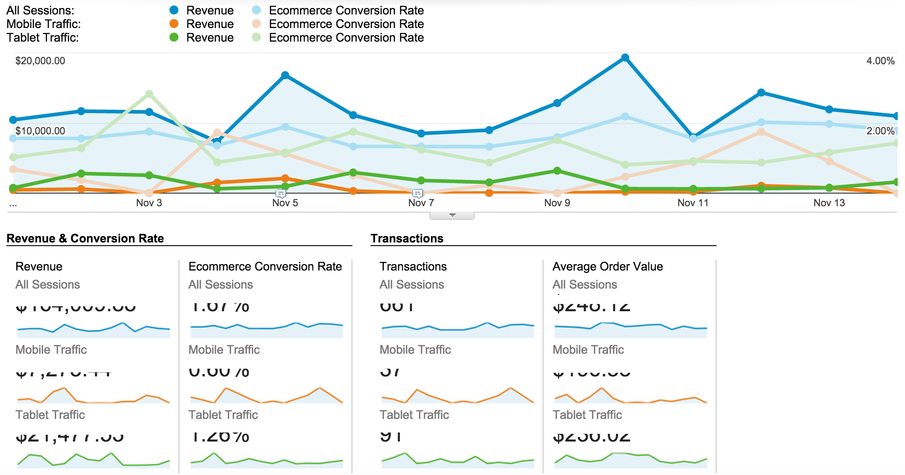
Google Analytics - eCommerce

Slide 12
Thanks !

